Slide 1
AVERAGE

Slide 2
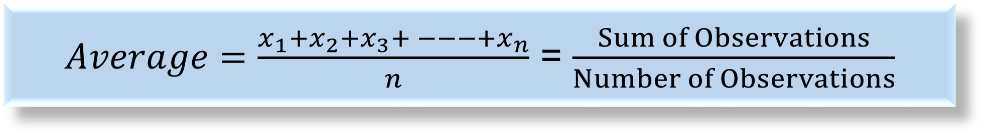
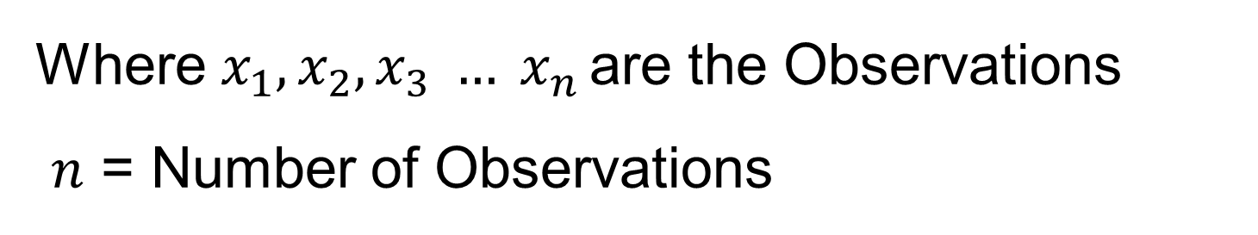
What is Average?
$Average=\frac{x_{1}+x_{2}+x_{3}+ −−−+x_{n}}{n}$ = $\frac{Sum of Observations}{Number of Observations}$
Where $x_{1}, x_{2}, x_{3} … x_{n }$are the Observations
$n$ = Number of Observations

Slide 3
Note: The average of any two or more quantities necessarily lies between the lowest and the highest value of the given data.

Slide 4
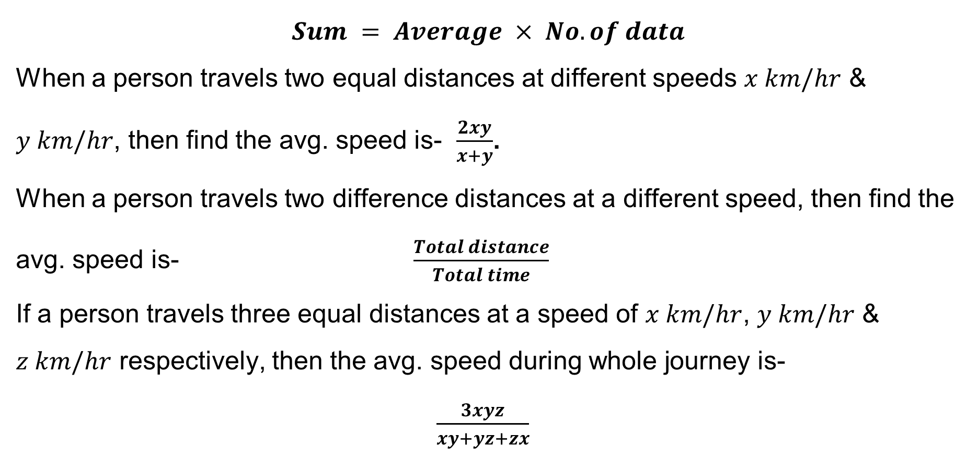
$$Sum = Average × No. of data$$
When a person travels two equal distances at different speeds $x km/hr$ & $y km/hr$, then find the avg. speed is- $\frac{2xy}{x+y}$.
When a person travels two difference distances at a different speed, then find the avg. speed is- $\frac{Total distance}{Total time}$
If a person travels three equal distances at a speed of $x km/hr$, $y km/hr$ & $z km/hr$ respectively, then the avg. speed during whole journey is-
$\frac{3xyz}{xy+yz+zx}$

Slide 5
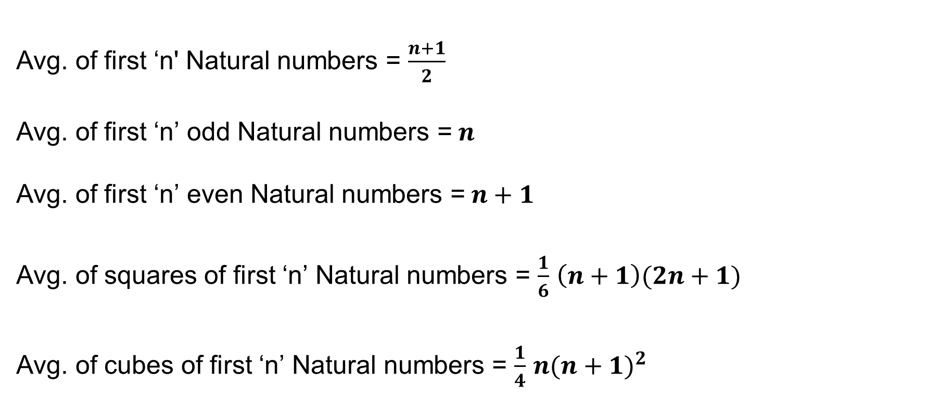
Avg. of first ‘n' Natural numbers = $\frac{n+1}{2}$
Avg. of first ‘n’ odd Natural numbers =$n$
Avg. of first ‘n’ even Natural numbers =$n+1$
Avg. of squares of first ‘n’ Natural numbers = $\frac{1}{6}$ $\left(n+1\right)(2n+1)$
Avg. of cubes of first ‘n’ Natural numbers = $\frac{1}{4}$ ${n(n+1)}^{2}$

Slide 6
Find the avg. age/weight with the help of Table-
Total no. of students | Avg. age/weight | Increase/Decrease | Teacher’s age/weight
20 | 15 | +1 | 36
40 | 17 | +1.5 | 78.5
Total no. of Teachers | Avg. age/weight | Increase/Decrease | Student’s age/weight
10 | 40 | -2 | 18
20 | 55 | -1.5 | 23.5

Slide 7
Alligation in Average
Quantity- A
Quantity- B
Avg. Quantity
C
Difference b/w
(B-C)
Difference b/w
(A-C)

Slide 8
BASICS OF AVERAGES
Average This is the arithmetic mean, and is calculated by adding a group of numbers and then dividing by the count of those numbers. For example, the average of 2, 3, 3, 5, 7, and 10 is 30 divided by 6, which is 5. Median The middle number of a group of numbers.
Average = Sum of Values/Number of Values
Shortcut:·
Average of first ʻnʼ natural numbers =(n+1)/2
Average of first ʻnʼ even numbers = (n + 1)
Average of first ʻnʼ odd numbers = n

Slide 9
AVERAGES
Q 1. If a, b, c, d & e are five consecutive odd integers, what is their average?
a + 4
(2) (abcde)/5
(3) 5 (a + b + c + d + e)
(4) a + 8
(5) None of these

Slide 10
AVERAGES
Q 1. If a, b, c, d & e are five consecutive odd integers, what is their average?
a + 4
(2) (abcde)/5
(3) 5 (a + b + c + d + e)
(4) a + 8
(5) None of these

Slide 11
AVERAGES
Q 2. The average salary of 20 workers in an office is Rs. 1900 per month. If the manager’s salary is added, the average becomes Rs. 2000 per month. The manager’s annual salary (in Rs.) is :
Rs. 4000
(2) Rs. 25200
(3) Rs. 48000
(4) Rs. 84000
(5) None of these

Slide 12
AVERAGES
Q 2. The average salary of 20 workers in an office is Rs. 1900 per month. If the manager’s salary is added, the average becomes Rs. 2000 per month. The manager’s annual salary (in Rs.) is :
Rs. 4000
(2) Rs. 25200
(3) Rs. 48000
(4) Rs. 84000
(5) None of these

Slide 13
AVERAGES
Q 3. In a certain primary school, there are 60 boys of 12 years old, 40 boys of 13 years old, 50 boys of 14 years old, and 50 boys of 15 years old. Among the total number of boys in the school, the average age is:
13.50
(2) 13
(3) 13.45
(4) 14
(5) None of these

Slide 14
AVERAGES
Q 3. In a certain primary school, there are 60 boys of 12 years old, 40 boys of 13 years old, 50 boys of 14 years old, and 50 boys of 15 years old. Among the total number of boys in the school, the average age is:
13.50
(2) 13
(3) 13.45
(4) 14
(5) None of these

Slide 15
AVERAGES
Q 4. The average age of 24 students and the class teacher is 16 years. If the class teacher’s age is excluded, the average reduces by 1 year. What is the age of the class teacher?
50 years
(2) 45 years
(3) 40 years
(4) Data inadequate
(5) None of these

Slide 16
AVERAGES
Q 4. The average age of 24 students and the class teacher is 16 years. If the class teacher’s age is excluded, the average reduces by 1 year. What is the age of the class teacher?
50 years
(2) 45 years
(3) 40 years
(4) Data inadequate
(5) None of these

Slide 17
AVERAGES
Q 5. The average of 8 numbers is 14. If 2 is subtracted from each given number, what will be the new average?
12
(2) 10
(3) 16
(4) 18
(5) None of these

Slide 18
AVERAGES
Q 5. The average of 8 numbers is 14. If 2 is subtracted from each given number, what will be the new average?
(1) 12
(2) 10
(3) 16
(4) 18
(5) None of these

Slide 19
AVERAGES
Q 6. The average of x numbers is 3x. If (x–1) is subtracted from each given number, what will be the new average?
(1) 2x + 1
(2) (x – 1)3
(3) 2x – 1
(4) Data inadequate
(5) None of these

Slide 20
AVERAGES
Q 6. The average of x numbers is 3x. If (x–1) is subtracted from each given number, what will be the new average?
(1) 2x + 1
(2) (x – 1)3
(3) 2x – 1
(4) Data inadequate
(5) None of these

Slide 21
AVERAGES
Q 7. The average age of 34 boys in a class is 14 years. If the teacher’s age is included, the average age of the boys and the teacher becomes 15 years. What is the teacher’s age?
48 years
(2) 46 years
(3) 49 years
(4) 45 years
(5) None of these

Slide 22
AVERAGES
Q 7. The average age of 34 boys in a class is 14 years. If the teacher’s age is included, the average age of the boys and the teacher becomes 15 years. What is the teacher’s age?
48 years
(2) 46 years
(3) 49 years
(4) 45 years
(5) None of these

Slide 23
AVERAGES
Q 8. The average weight of 8 persons increases by 1.5kg. If a person whose weight is 65kg is replaced by a new person, what could be the weight of the new person?
76kg
(2) 77kg
(3) 76.5kg
(4) Data inadequate
(5) None of these

Slide 24
AVERAGES
Q 8. The average weight of 8 persons increases by 1.5kg. If a person whose weight is 65kg is replaced by a new person, what could be the weight of the new person?
76kg
(2) 77kg
(3) 76.5kg
(4) Data inadequate
(5) None of these

Slide 25
AVERAGES
Q 9. The average age of the class consisting of 24 students decreases by 3 months when 1 boy aged 20 years is replaced by a new boy. Find the age of the new boy:
14 years
(2) 16 years
(3) 17 years
(4) 18 years
(5) None of these

Slide 26
AVERAGES
Q 9. The average age of the class consisting of 24 students decreases by 3 months when 1 boy aged 20 years is replaced by a new boy. Find the age of the new boy:
14 years
(2) 16 years
(3) 17 years
(4) 18 years
(5) None of these

Slide 27
AVERAGES
Q 10. The average marks obtained by 77 candidates in a certain examination are 17. If the average marks of passed candidates are 19 and that of the failed candidates is 8, what is the number of candidates who passed the examination?
36
(2) 63
(3) 40
(4) 70
(5) None of these

Slide 28
AVERAGES
Q 10. The average marks obtained by 77 candidates in a certain examination are 17. If the average marks of passed candidates are 19 and that of the failed candidates is 8, what is the number of candidates who passed the examination?
36
(2) 63
(3) 40
(4) 70
(5) None of these

Slide 29
AVERAGES
Q 11. The average of 13 results is 39. The average of the first five is 38 and the average of the last seven is 36. Find the value of the 6th number :
64
(2) 46
(3) 65
(4) 56
(5) None of these

Slide 30
AVERAGES
Q 11. The average of 13 results is 39. The average of the first five is 38 and the average of the last seven is 36. Find the value of the 6th number :
64
(2) 46
(3) 65
(4) 56
(5) None of these

Slide 31
AVERAGES
Q 12. A batsman, in his 19th innings, missed a century by 2 runs and thereby increased his average by 3. What is his average after 19 innings?
54
(2) 44
(3) 45
(4) 43
(5) None of these

Slide 32
AVERAGES
Q 12. A batsman, in his 19th innings, missed a century by 2 runs and thereby increased his average by 3. What is his average after 19 innings?
54
(2) 44
(3) 45
(4) 43
(5) None of these

Slide 33
AVERAGES
Q 13. An equal distance from A to B is covered by a man at 40km/h. The person rides back the same distance at 30km/h. Find his approximate average speed during the whole journey.
34km/h
(2) 35.29km/h
(3) 34.29km/h
(4) 35km/h
(5) None of these

Slide 34
AVERAGES
Q 13. An equal distance from A to B is covered by a man at 40km/h. The person rides back the same distance at 30km/h. Find his approximate average speed during the whole journey.
34km/h
(2) 35.29km/h
(3) 34.29km/h
(4) 35km/h
(5) None of these

Slide 35
AVERAGES
Q 14. A person divides his total route of a journey into three equal parts and decides to travel the three parts with speeds of 20, 15, and 10 km/hr, respectively. Find his average speed during the whole journey.
13(11/13) km/h
(2) 11(11/13) km/h
(3) 13(3/13) km/h
(4) 11(3/13) km/h
(5) None of these

Slide 36
AVERAGES
Q 14. A person divides his total route of a journey into three equal parts and decides to travel the three parts with speeds of 20, 15, and 10 km/hr, respectively. Find his average speed during the whole journey.
(1) 13(11/13) km/h
(2) 11(11/13) km/h
(3) 13(3/13) km/h
(4) 11(3/13) km/h
(5) None of these

Slide 37
AVERAGES
Q 15. A person covers 18 km at 6km/h, 16km at 8km/h and 30km at 6km/h. Find the average speed in covering the whole distance:
6.5km/h
(2) 6.4km/h
(3) 6.2km/h
(4) 6km/h
(5) None of these

Slide 38
AVERAGES
Q 15. A person covers 18 km at 6km/h, 16km at 8km/h and 30km at 6km/h. Find the average speed in covering the whole distance:
6.5km/h
(2) 6.4km/h
(3) 6.2km/h
(4) 6km/h
(5) None of these

Slide 39
AVERAGES
Q 16. A person runs the first 1/4 of the distance at a speed of 8 km/h, the next 3/5 at a speed of 6 km/h, and the remaining distance at a speed of 10 km/h. Find his average speed:
17km/h
(2) 17.87km/h
(3) 17.78km/h
(4) 18.5km/h
(5) 6(98/117)km/h

Slide 40
AVERAGES
Q 16. A person runs the first 1/4 of the distance at a speed of 8 km/h, the next 3/5 at a speed of 6 km/h, and the remaining distance at a speed of 10 km/h. Find his average speed:
17km/h
(2) 17.87km/h
(3) 17.78km/h
(4) 18.5km/h
(5) 6(98/117)km/h

Slide 41
AVERAGES
Q 17. The average salary of the entire staff in an office is Rs. 130 per month. The average salary of officers is Rs. 540 and that of non-officers is Rs. 114. If the number of officers is 16, find the number of non-officers in the office:
140
(2) 410
(3) 510
(4) 150
(5) None of these

Slide 42
AVERAGES
Q 17. The average salary of the entire staff in an office is Rs. 130 per month. The average salary of officers is Rs. 540 and that of non-officers is Rs. 114. If the number of officers is 16, find the number of non-officers in the office:
140
(2) 410
(3) 510
(4) 150
(5) None of these

Slide 43
AVERAGES
Q 18. There were 42 students in a hostel. If the number of students increases by 7, the expenses of the mess increase by Rs. 32.5 per day while the average expenditure per head diminishes by Rs. 1.5. Find the original expenditure of the mess:
636
(2) 536
(3) 630
(4) 656
(5) None of these

Slide 44
AVERAGES
Q 18. There were 42 students in a hostel. If the number of students increases by 7, the expenses of the mess increase by Rs. 32.5 per day while the average expenditure per head diminishes by Rs. 1.5. Find the original expenditure of the mess:
636
(2) 536
(3) 630
(4) 656
(5) None of these

Slide 45
AVERAGES
Q 19. The average temperature on Monday, Tuesday, and Wednesday was 40°C. The average temperature on Tuesday, Wednesday, and Thursday was 41°C. If the temperature on Thursday was 42°C, what was the temperature on Monday?
39°C
(2) 45°C
(3) 44°C
(4) 40°C
(5) None of these

Slide 46
AVERAGES
Q 19. The average temperature on Monday, Tuesday, and Wednesday was 40°C. The average temperature on Tuesday, Wednesday, and Thursday was 41°C. If the temperature on Thursday was 42°C, what was the temperature on Monday?
(1) 39°C
(2) 45°C
(3) 44°C
(4) 40°C
(5) None of these

Slide 47
AVERAGES
Q 20. The average attendance of a college for the first three days of a week is 325, and for the first four days, it is 320. How many were present on the fourth day?
305
(2) 350
(3) 530
(4) 503
(5) None of these

Slide 48
AVERAGES
Q 20. The average attendance of a college for the first three days of a week is 325, and for the first four days, it is 320. How many were present on the fourth day?
(1) 305
(2) 350
(3) 530
(4) 503
(5) None of these

Slide 49
AVERAGES
Q 21. An airplane covers the four sides of a square field at speeds of 200, 400, 600, and 800 km/hr. What is the average speed of the plane during the entire journey?
600km/h
(2) 400km/h
(3) 500km/h
(4) 384km/h
(5) None of these

Slide 50
AVERAGES
Q 21. An airplane covers the four sides of a square field at speeds of 200, 400, 600, and 800 km/hr. What is the average speed of the plane during the entire journey?
600km/h
(2) 400km/h
(3) 500km/h
(4) 384km/h
(5) None of these

Slide 51
AVERAGES
Q 22. The average age of the three boys is 15 years. Their ages are in the ratio 3 : 5 : 7. The age of the oldest is:
7 years
(2) 14 years
(3) 20 years
(4) 21 years
(5) None of these

Slide 52
AVERAGES
Q 22. The average age of the three boys is 15 years. Their ages are in the ratio 3 : 5 : 7. The age of the oldest is:
7 years
(2) 14 years
(3) 20 years
(4) 21 years
(5) None of these

Slide 53
AVERAGES
Q 23. The population of a town increased by 20% during the first year, increased by 25% during the next year, and increased by 44% during the third year. Find the average rate of increase during 3 years :
36.87%
(2) 37.68%
(3) 38(2/3)%
(4) 40%
(5) None of these

Slide 54
AVERAGES
Q 23. The population of a town increased by 20% during the first year, increased by 25% during the next year, and increased by 44% during the third year. Find the average rate of increase during 3 years :
36.87%
(2) 37.68%
(3) 38(2/3)%
(4) 40%
(5) None of these

Slide 55
AVERAGES
Q 24. An investor earns a 3% return on 1/4 of this capital, 5% on 2/3 of his capital, and 11% on the remaining capital. What is the average rate of return he earns on his total capital?
(1) 5%
(2) 10%
(3) 5.5%
(4) 10.5%
(5) None of these

Slide 56
AVERAGES
Q 24. An investor earns a 3% return on 1/4 of this capital, 5% on 2/3 of his capital, and 11% on the remaining capital. What is the average rate of return he earns on his total capital?
(1) 5%
(2) 10%
(3) 5.5%
(4) 10.5%
(5) None of these

Slide 57
AVERAGES
Q 25. The average of 8 readings is 24.3, out of which the average for the first two is 18.5 and that of the next three is 21.2. If the sixth reading is 3 less than the seventh and 8 less than the eighth, what is the sixth reading?
24.8
(2) 26.5
(3) 27.6
(4) 29.4
(5) None of these

Slide 58
AVERAGES
Q 25. The average of 8 readings is 24.3, out of which the average for the first two is 18.5 and that of the next three is 21.2. If the sixth reading is 3 less than the seventh and 8 less than the eighth, what is the sixth reading?
24.8
(2) 26.5
(3) 27.6
(4) 29.4
(5) None of these

Slide 59
AVERAGES
Q 26. The average age of a family of 6 members is 22 years. If the age of the youngest member is 7 years, the average age of the family at the birth of the youngest member was:
15 years
(2) 17 years
(3) 17.5 years
(4) 18 years
(5) None of these

Slide 60
AVERAGES
Q 26. The average age of a family of 6 members is 22 years. If the age of the youngest member is 7 years, the average age of the family at the birth of the youngest member was:
15 years
(2) 17 years
(3) 17.5 years
(4) 18 years
(5) None of these

Slide 61
AVERAGES
Q 27. The average height of 40 students is 163 cm. On a particular day, three students A, B, and C were absent and the average of the remaining 37 students was found to be 162 cm. If A, and B have equal heights and the height of C is 2 cm less than that of A, find the height of A:
(1) 176cm
(2) 166cm
(3) 180cm
(4) 186cm
(5) None of these

Slide 62
AVERAGES
Q 27. The average height of 40 students is 163 cm. On a particular day, three students A, B, and C were absent and the average of the remaining 37 students was found to be 162 cm. If A, and B have equal heights and the height of C is 2 cm less than that of A, find the height of A:
(1) 176cm
(2) 166cm
(3) 180cm
(4) 186cm
(5) None of these

Slide 63
AVERAGES
Q 28. The average weight of the 3 men A, B, and C is 84kg. Another man D, joins the group and the average now becomes 80kg. If another man, E, whose weight is 3kg more than that of D, replaces A, then the average weight of B, C, D, and E becomes 79kg. The weight of A is:
70kg
(2) 72kg
(3) 75kg
(4) 80kg
(5) None of these

Slide 64
AVERAGES
Q 28. The average weight of the 3 men A, B, and C is 84kg. Another man D, joins the group and the average now becomes 80kg. If another man, E, whose weight is 3kg more than that of D, replaces A, then the average weight of B, C, D, and E becomes 79kg. The weight of A is:
70kg
(2) 72kg
(3) 75kg
(4) 80kg
(5) None of these

Slide 65
AVERAGES
Q 29. The bowling average of a cricketer was 12.4. He improves his bowling average by 0.2 points when he takes 5 wickets for 26 runs in his last match. The number of wickets taken by him before the last match was
(1) 150
(2) 200
(3) 125
(4) 175

Slide 66
AVERAGES
Q 29. The bowling average of a cricketer was 12.4. He improves his bowling average by 0.2 points when he takes 5 wickets for 26 runs in his last match. The number of wickets taken by him before the last match was
(1) 150
(2) 200
(3) 125
(4) 175

Slide 67
Thank you

